Slide 1
Bell Work
What do you know about Joan of Arc?
Write down as many bullet points as you can.
If you have not finished your Instagram, please finish that.

Slide 2
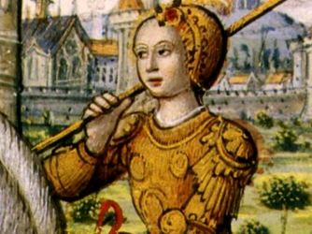
I can explain the significance of Joan of Arc.
7.49 Gather relevant information from multiple sources about Henry V, Hundreds Year War, and Joan of Arc. (H, G, P)

Slide 3
Notes Set-Up
Background
Journey to Orleans
DO NOT WRITE EVERY SINGLE WORD DOWN AS WE GO THROUGH THIS LESSON.
Look at this as a story that you are summarizing.
JOAN OF ARC
Downfall
From Witch to Saint

Slide 4
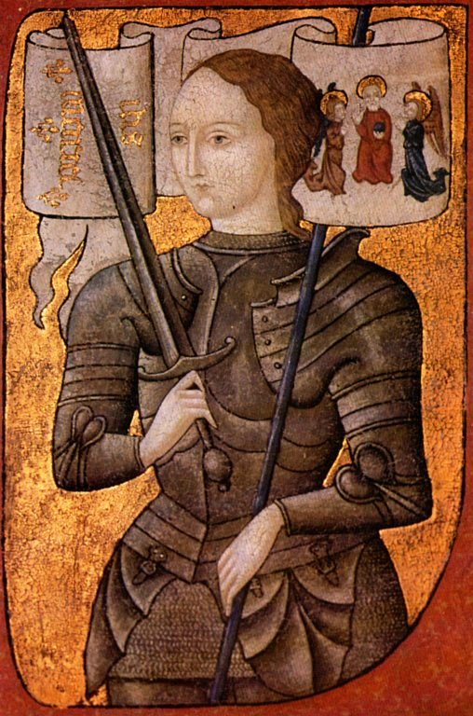
Introduction
1412 - 1431
Joan of Arc, a peasant girl living in medieval France, believed that God had chosen her to lead France to victory in its long-running war with England.

Slide 5
Background
She was not taught to read or write, but her pious mother instilled in her a deep love for the Catholic Church and its teachings. At the time, France had long been torn apart by a bitter conflict with England (later known as the Hundred Years’ War), in which England had gained the upper hand.
King Henry V was made ruler of both England and France. His son, Henry VI, succeeded him in 1422. Along with its French allies, England occupied much of northern France, and many in Joan’s village were forced to abandon their homes under threat of invasion.
At the age of 13, Joan began to hear voices, which she determined had been sent by God to give her a mission of overwhelming importance: to save France by expelling its enemies, and to install Charles as its rightful king.
http://www.smithsonianchannel.com/videos/joan-of-arcs-inner-voices/16476

Slide 6
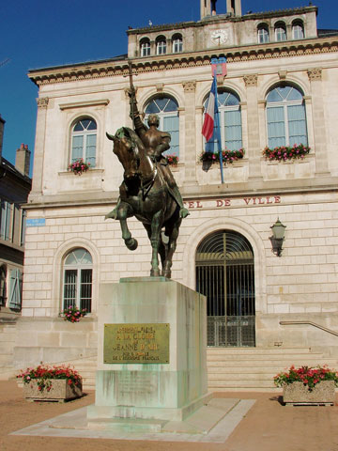
Joan’s Journey to Orleans
In May 1428, Joan made her way to Vaucouleurs, a nearby stronghold of those loyal to Charles.
Initially rejected by the local leader, she persisted, attracting a small band of followers who believed her claims to be the girl who (according to a popular prophecy) was destined to save France.
When the leader relented, Joan cropped her hair and dressed in men’s clothes to make the 11-day journey across enemy territory to Chinon, site of the crown prince’s palace.

Slide 7
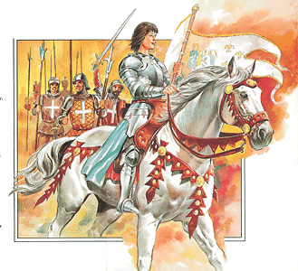
Joan’s Journey to Orleans
Joan promised Charles she would see him crowned king at Reims, the traditional site of French royal investiture, and asked him to give her an army to lead to Orléans, then under siege from the English.
Against the advice of most of his counselors, Charles granted her request, and Joan set off for Orléans in March of 1429.
Joan led several French assaults against the enemy, forcing their retreat.

Slide 8
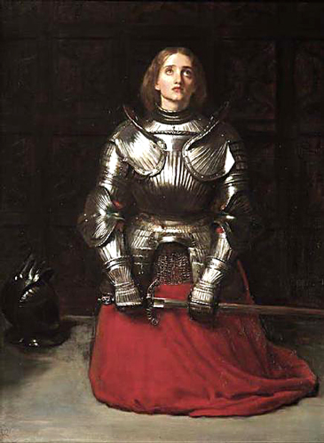
Downfall of Joan of Arc
After such a miraculous victory, Joan’s reputation spread far and wide among French forces.
She and her followers escorted Charles across enemy territory to Reims, taking towns that resisted by force and enabling his coronation as King Charles VII.
In the spring of 1430, the king ordered Joan to confront a Burgundian (Allies of the English in France) assault. In her effort to defend the town and its inhabitants, she was thrown from her horse, and was left outside the town’s gates as they closed. The Burgundians took her captive, and brought her to the castle of Bouvreuil, occupied by the English.

Slide 9
From Witch to Saint
In the trial that followed, Joan was ordered to answer to some 70 charges against her, including witchcraft, heresy and dressing like a man. The Anglo-Burgundians wanted to get rid of the young leader as well as discredit Charles, who owed his coronation to her.
In attempting to distance himself from an accused heretic and witch, the French king made no attempt to negotiate Joan’s release.
In May 1431, after a year in captivity and under threat of death, Joan relented and signed a confession denying that she had ever received divine guidance.
Several days later, however, she defied orders by again donning men’s clothes, and authorities pronounced her death sentence. On the morning of May 30, at the age of 19, Joan was taken to the old market place of Rouen and burned at the stake

Slide 10
From Witch to Saint
Her fame only increased after her death and 20 years later a new trial ordered by Charles VII cleared her name.
Long before Pope Benedict XV canonized her in 1920, Joan of Arc had attained mythic stature, inspiring numerous works of art and literature over the centuries and becoming the patron saint of France.

Slide 11
Video Summary
https://www.youtube.com/watch?v=0q3uAu1EuRc

Slide 12
Exit Quiz
Read the article and answer the questions on the worksheet.
Put it in the tray when you are done.

